Slide 1
Incorporating Cybersecurity Inputs into the MRL Matrix
October 2020
David Karr
Tech Advisor for Mfg/QA
AFLCMC/EZSM
david.karr@us.af.mil

Slide 2
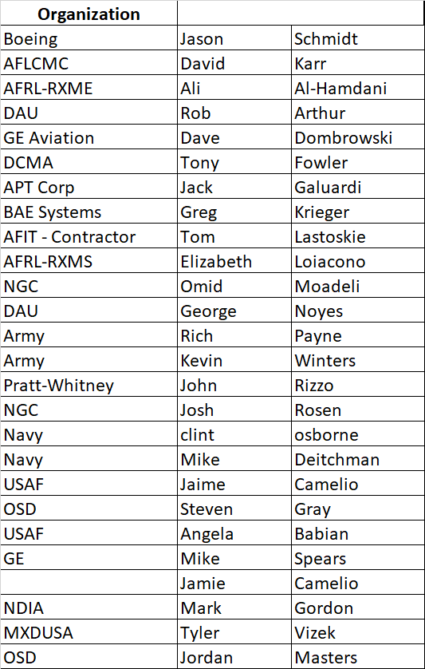
Team Members

Slide 3
Scope
Product Systems – software installed on customer product.
(IT) Corporate functions – Finance, HR, Supply Chain, Communications, Networking, etc.
(OT) Production Assets – equipment & tools loaded with software utilized on the manufacturing floor.

Slide 4
Status
Incorporated inputs from 2019 MRL Workshop
Continued to scrub criteria
  Cyber criteria can be used for either a stand-alone thread/sub-thread or incorporated into existing threads/sub-threads
Added examples of Objective Evidence
Addressed comments from OSD and NIST
Developing draft words for MRL Deskbook to explain cyber approach in MRLs

Slide 5
Excerpt

Slide 6
Next Steps & Approval Process?
Cyber team completes draft
MRL Working Group Reviews
Cyber team incorporates comments
Reviewed at MRL Workshop
Cyber team incorporates comments
Final review by MRL Working Group
Incorporate into MRL Matrix
Some poor sap is stuck with developing User’s Guide inputs
N/A
N/A

